Slide 1
Land Development Committee
September 17, 2019

Slide 2
Our work is focused on unlocking
the value of underutilized real
estate throughout Hamilton County
to drive economic growth, create
jobs, improve social stability, and
create shared prosperity for all
residents. Vision 2022 has acted as
our organization’s guidepost since
its adoption in 2015, focusing our
work in three strategic areas:

Slide 3
2100 SECTION ROAD
56-ACRES
FOR SALE: $7,560,000
Acquired: June 2016
Total Redevelopment Investment: $13,500,000
Available: September 2017

Slide 4
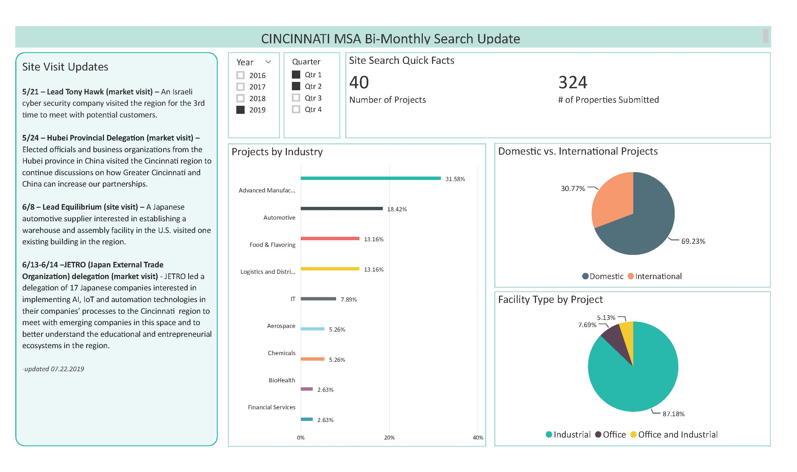
REDI SITE SEARCH UPDATES – JULY 2019

Slide 5
Site Marketing

Slide 6
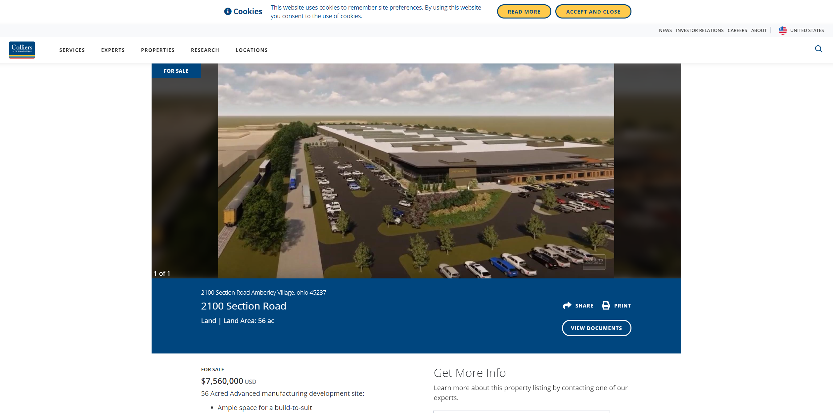
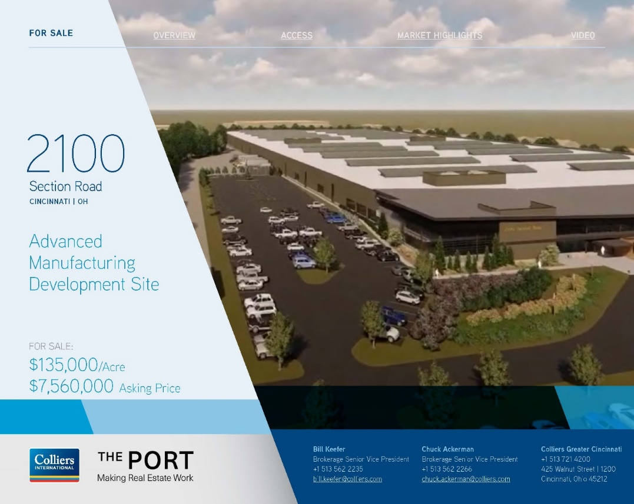
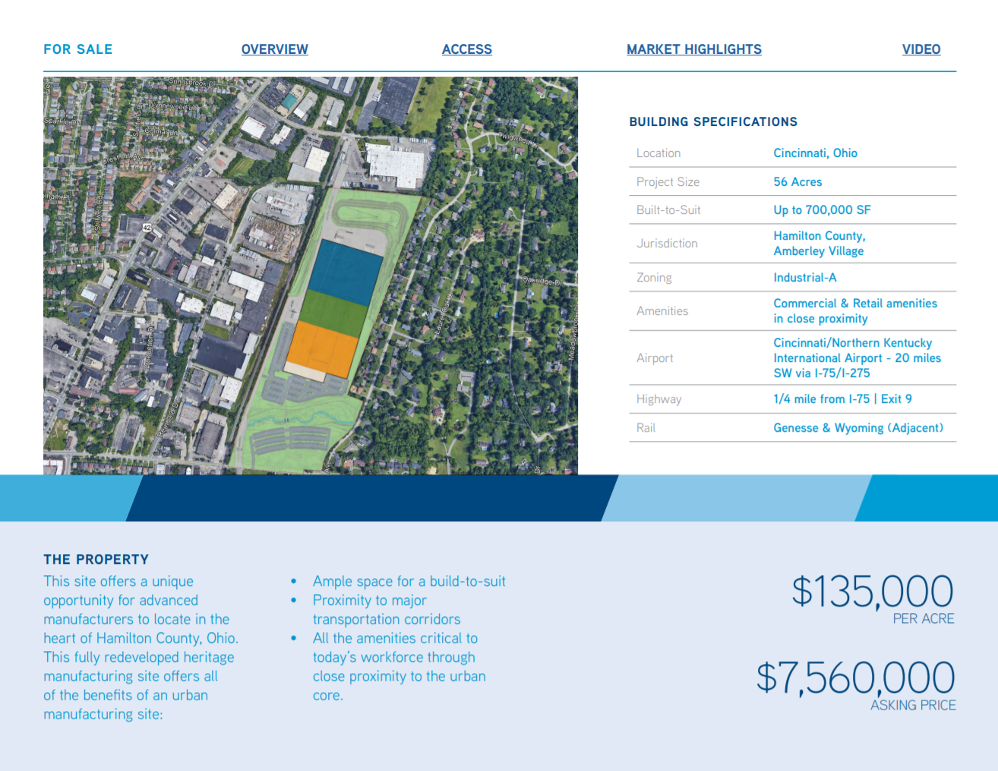
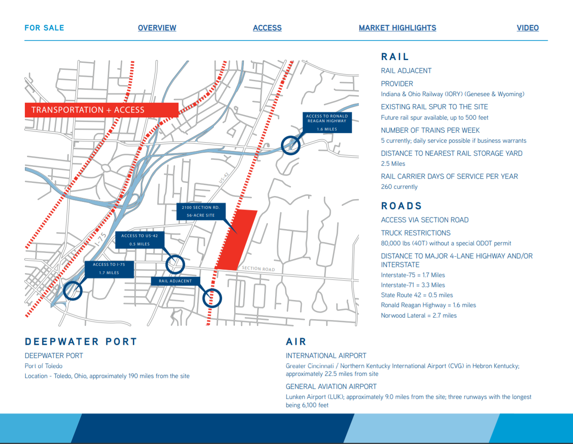
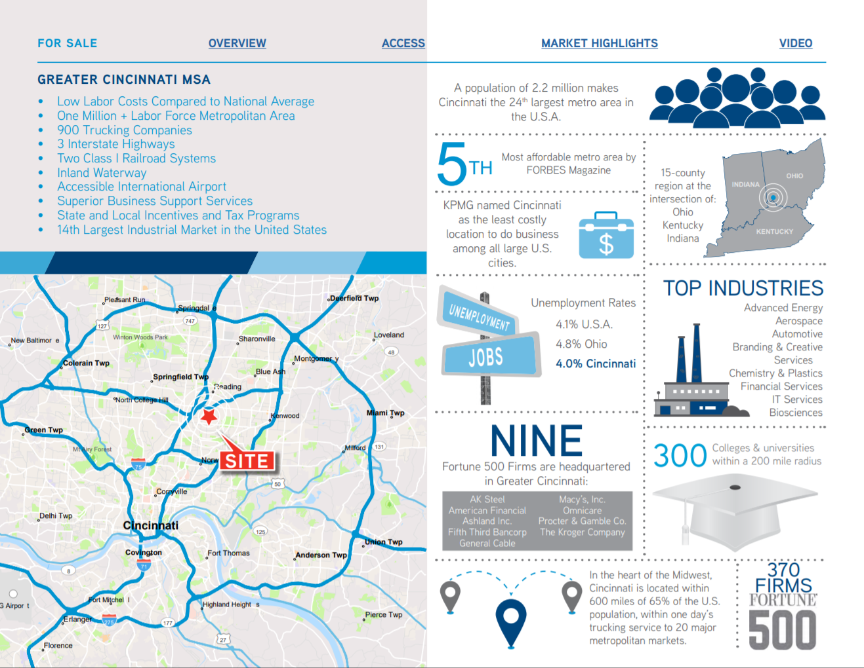
COLLIERS MARKETING COLLATERAL
2100 Section Road

Slide 7
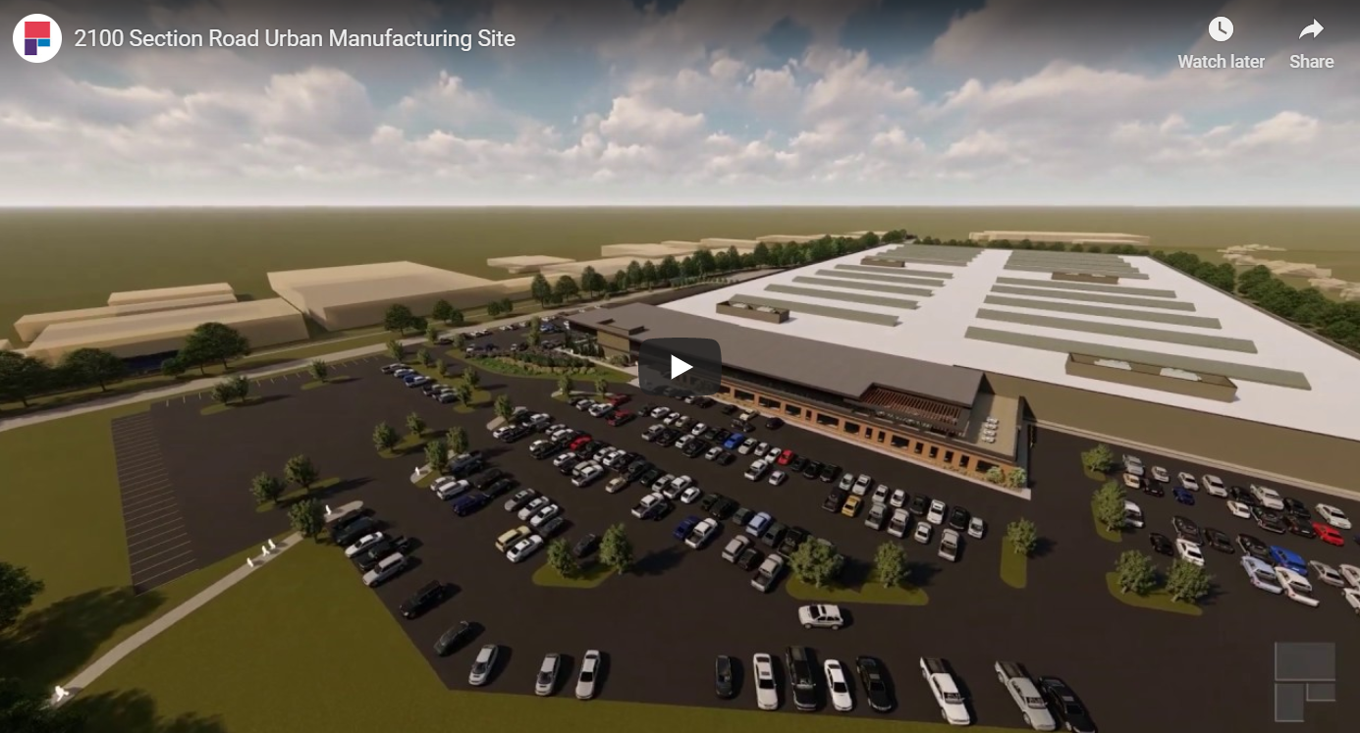
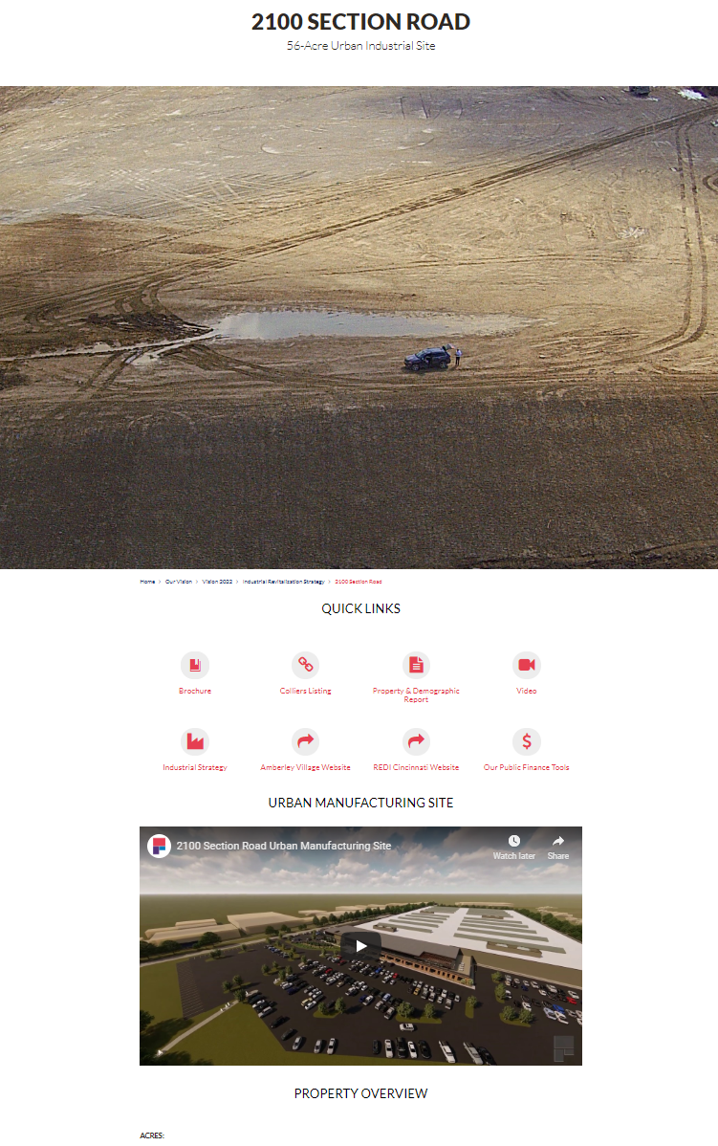
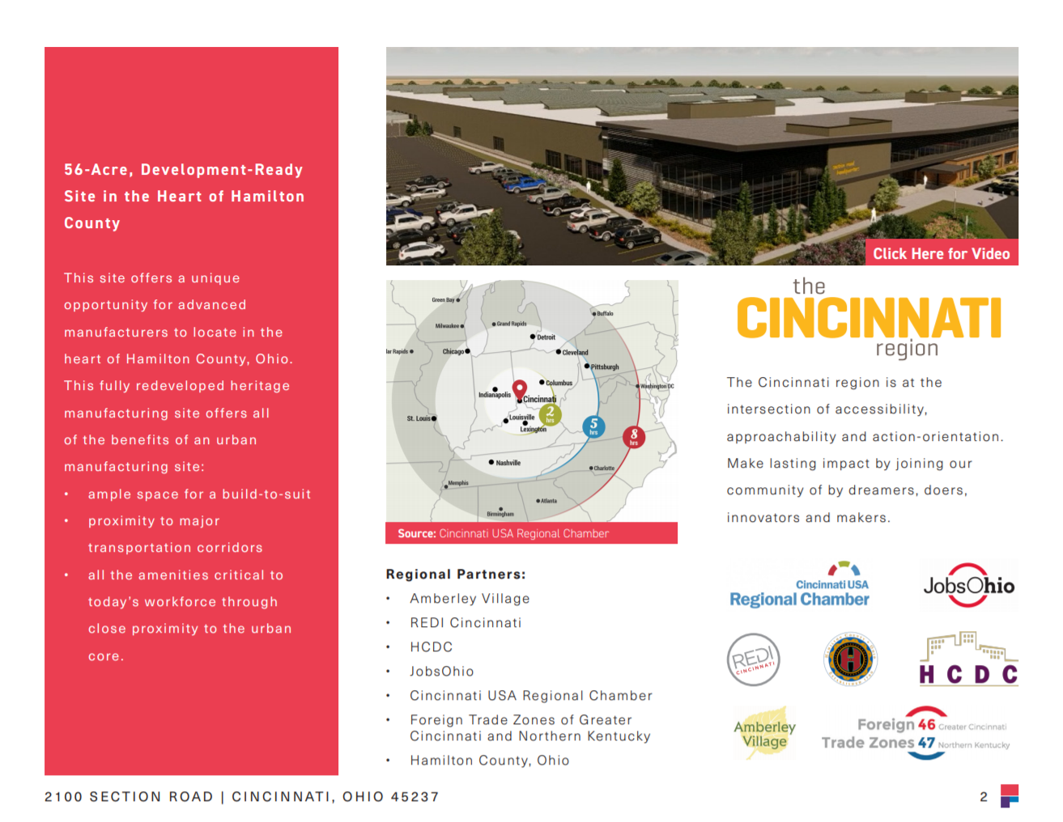
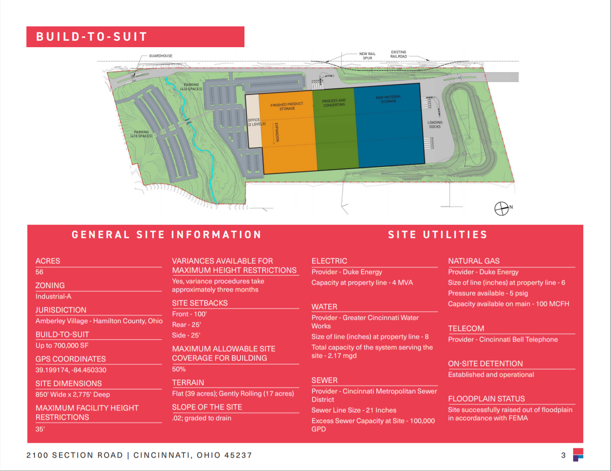
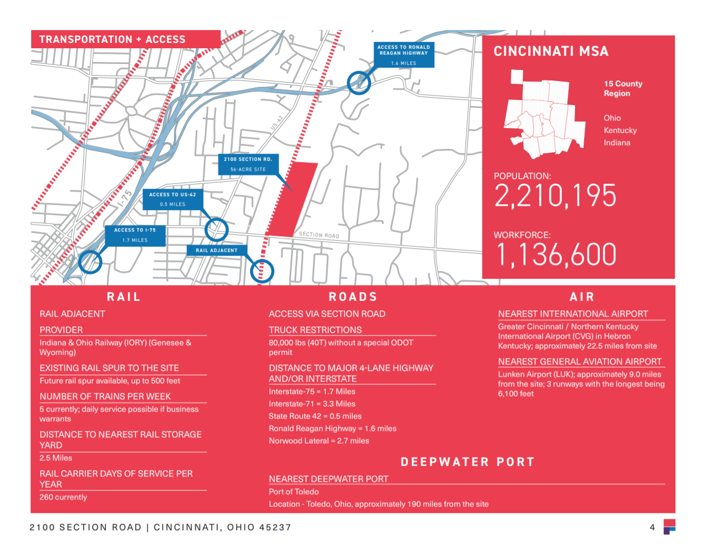
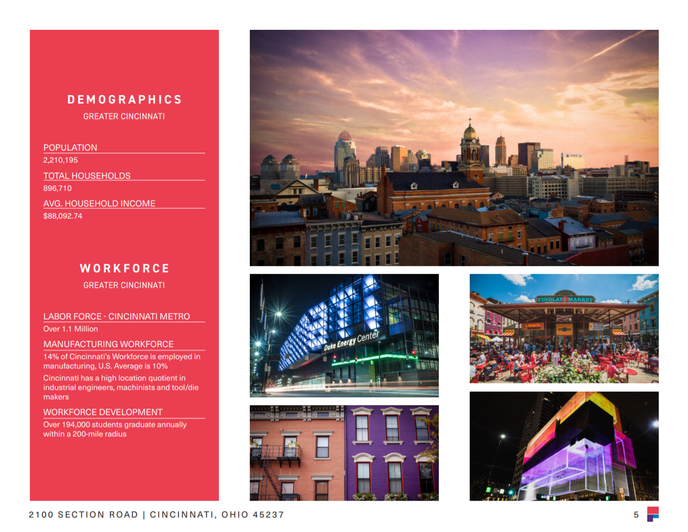
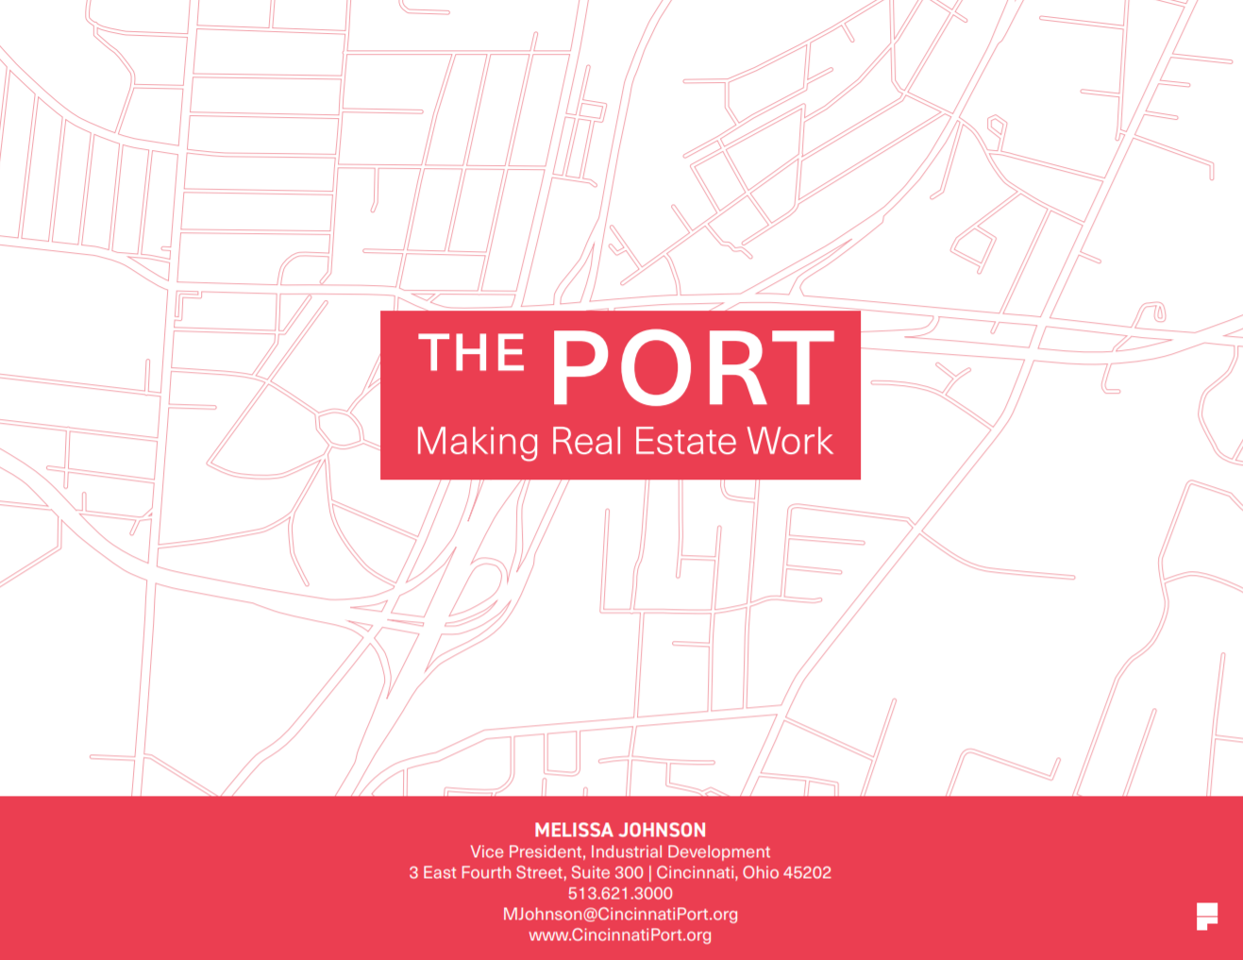
THE PORT MARKETING COLLATERAL
Website, Video and Brochure

Slide 8
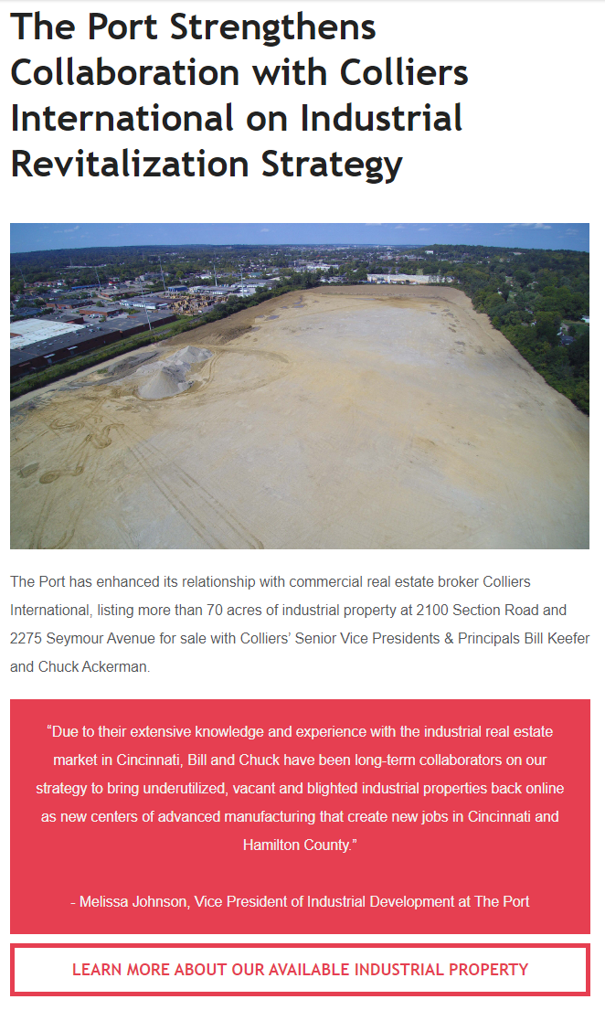
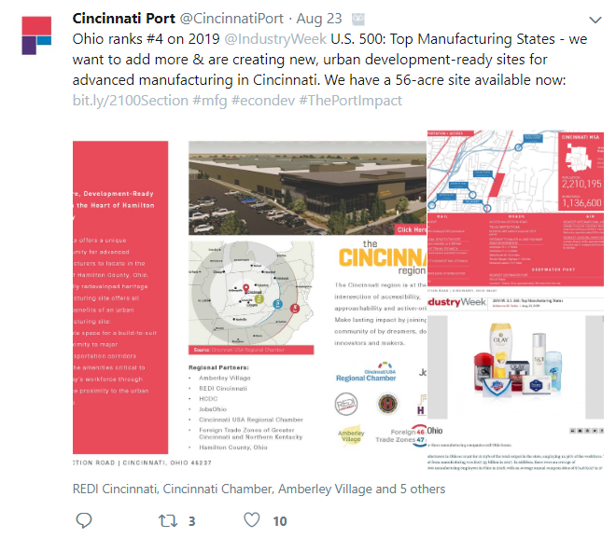
THE PORT MARKETING COLLATERAL
Newsletter, Social Media and Tours

Slide 9
REGIONAL REAL ESTATE NETWORKS
Social Media Channels:
Twitter
LinkedIn

